Slide 1

Facebook Marketplace Data Analysis
Analysis and Insights from Thai Fashion and Cosmetics Retail Sellers
By,
Aditya M
VVCE, Mysore

Slide 2
Introduction:
Objective: To analyze Facebook Marketplace data to gain insights into engagement metrics and trends.
Dataset Summary:
Data from 10 Thai Facebook Live fashion and cosmetics sellers.
Number of instances: 7050.
Number of attributes: 16 (reduced to 14 after removing redundant ones).
Data Preprocessing:
Data Cleaning:
Handled missing values by filling them with 0.
One-hot encoding for categorical features.
Feature Engineering:
Extracted features such as hour_published and day_of_week from status_published.

Slide 3
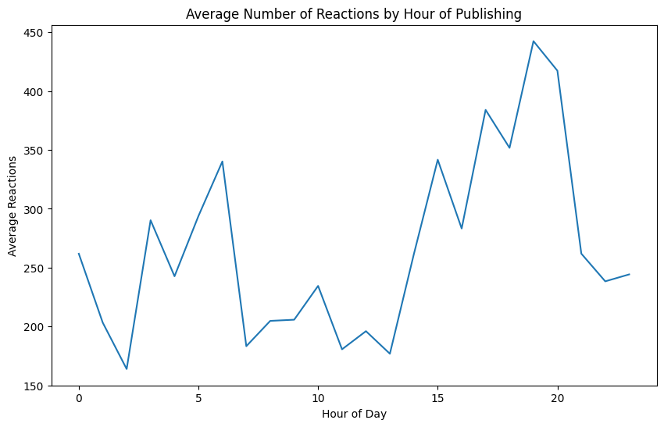
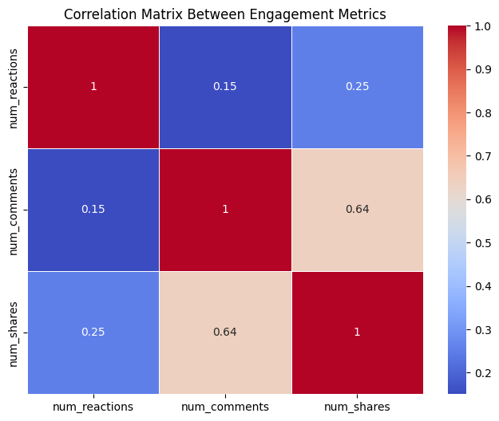
Effect of Time on Reactions:
Key Insight:
The highest average number of reactions was observed at hour 15 (3 PM) with X average reactions.
Posting during peak hours can maximize audience engagement.
Correlation Analysis:
Key Insights:
Strong positive correlation between num_reactions and num_comments.
High correlation between num_reactions and num_shares, indicating that popular posts tend to be shared more.

Slide 4
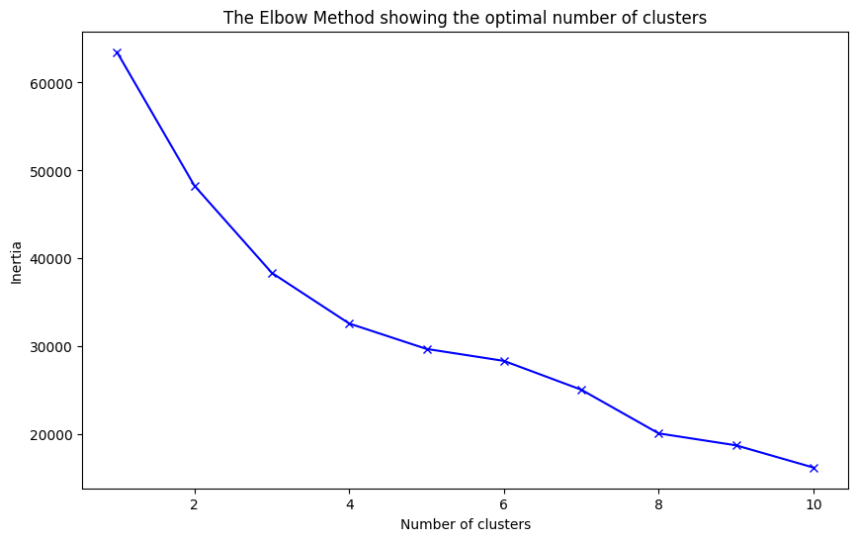
Elbow Method for Optimal Clusters:
Key Insight:
The elbow method suggests an optimal number of 4 clusters.
The dataset was segmented into four distinct groups for further analysis.
Cluster Summary:
Cluster Characteristics:
Cluster 1: High engagement posts.
Cluster 2: Moderate engagement.
Cluster 3: Low engagement posts.
Cluster 4: High specific metrics such as high shares but low reactions.

Slide 5
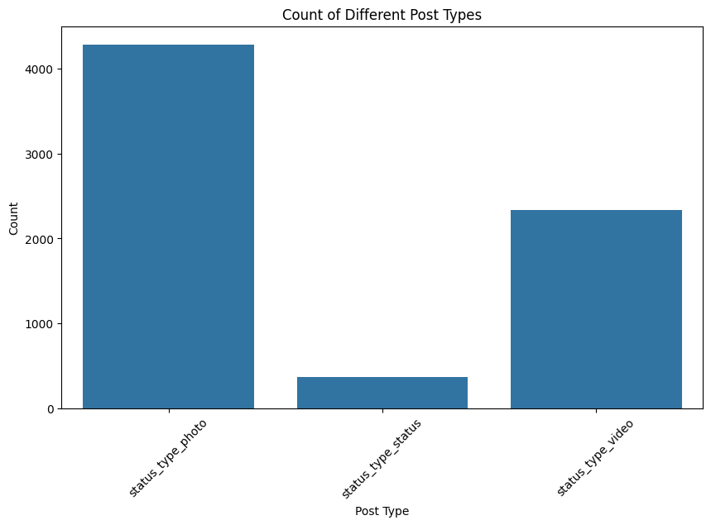
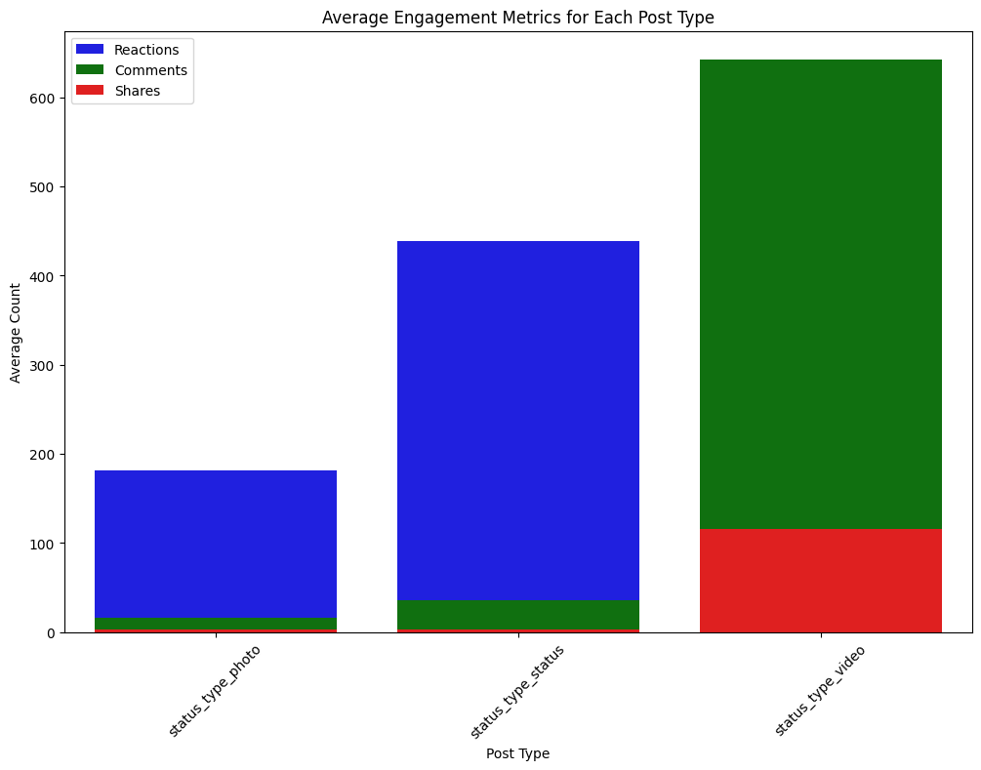
Count of Different Types of Posts:
Key Insights:
The most common type of post was video, followed by photos.
Status posts and links were less frequent.
Average Engagement Metrics by Post Type:
Engagement Insights:
Video posts received the highest average number of reactions and comments.
Photo posts performed well in terms of shares.
Status posts and links generally received lower engagement compared to other types.

Slide 6
Conclusion and Recommendations:
Key Findings:
Reactions peak during specific hours.
High correlation between reactions, comments, and shares.
Video posts have the highest engagement.
Clustering identified different levels of post engagement.
Recommendations:
Post during peak hours for maximum engagement.
Utilize video content to drive engagement.
Limitations and Future Work:
Limitations:
Data limited to 10 Thai sellers; results may not generalize.
Missing values were handled, which could affect precision.
Future Work:
Analysis with a larger dataset.
Use other clustering methods for comparison.

